Slide 1


Slide 2


TestNG introduction

Slide 3

Topics:
What is TestNG?
Why are we using it?
Testing frameworks overview
TestNG basics
TestNG assertions
TestNG annotations
Selenium testing with TestNG

Slide 4
After today’s session you should be able to:
Write tests using TestNG
Integrate TestNG and Selenium
Use assertions in tests
Control test flow using annotations

Slide 5
The history of TestNG…

Slide 6

Testing Tools (Frameworks)
TestNG, Junit, Nunit etc…
These tools enables unit testing, functional testing...
Provides assertions for verifying
We can use annotation to control test flow
We can generate some reports

Slide 7
Let’s implement TestNG
To do that we need to go to mvnrepository, and get the dependency
Normally we also need to add the plug-in to the IDE as well but the IntelliJ comes with it, so we don’t have to.
If it was Eclipse we would have to.

Slide 8
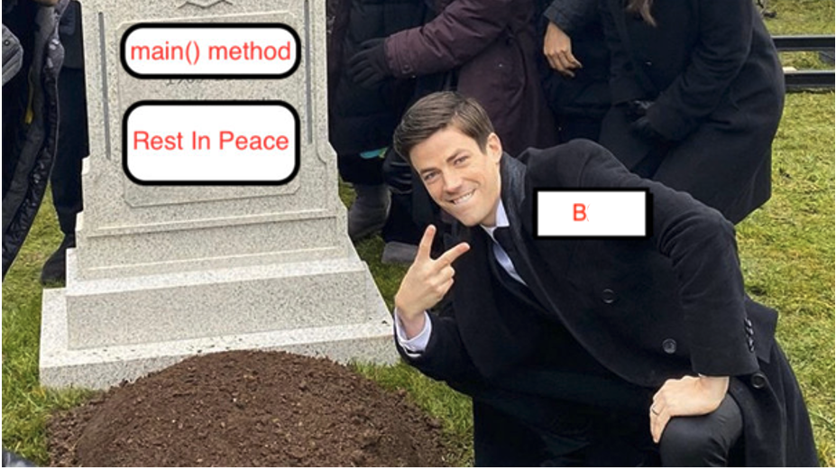
From today we will not be using main method
B25

Slide 9
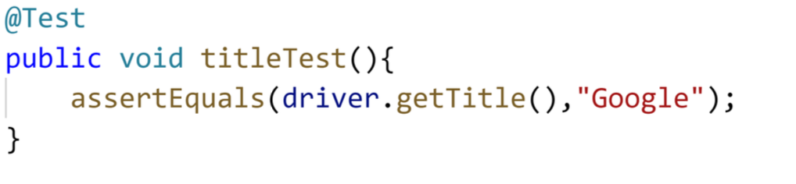
@Test
Indicates that method is a test method. Test method where we do assertions.

Slide 10
@Test is the main annotation where we create the test
All of the other annotations are there to only create & support structure and flow around @Test annotation

Slide 11
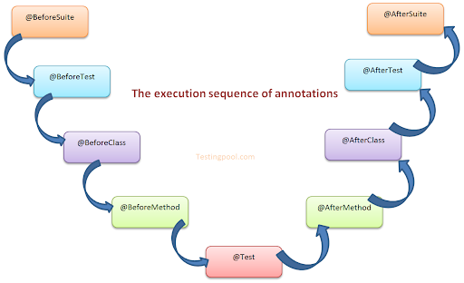
All TestNG annotations in the order they are executed

Slide 12
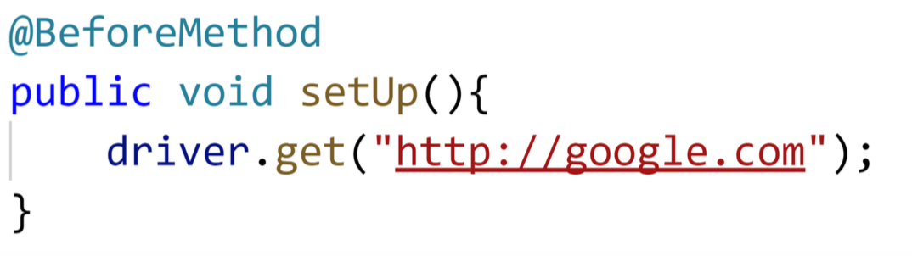
@BeforeMethod
Method with this annotation will always run once before every @Test method
Usually used for setting up for every test

Slide 13
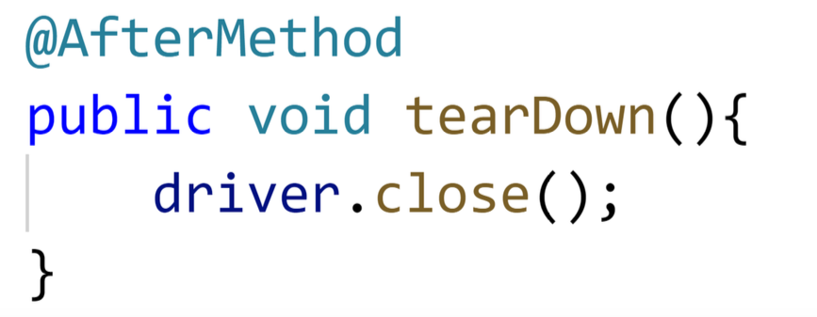
@AfterMethod
Basically runs once after every @Test
Usually used for closing down setups for every test

Slide 14
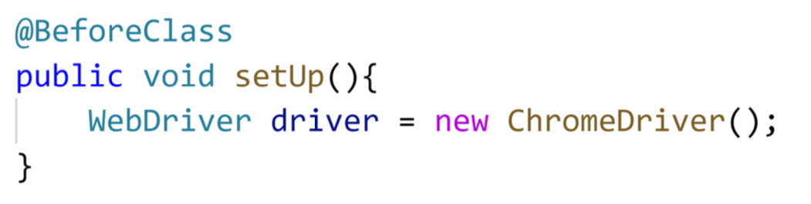
@BeforeClass
Method with this annotation will always run once before all of the other methods in this class
Usually used for setups

Slide 15
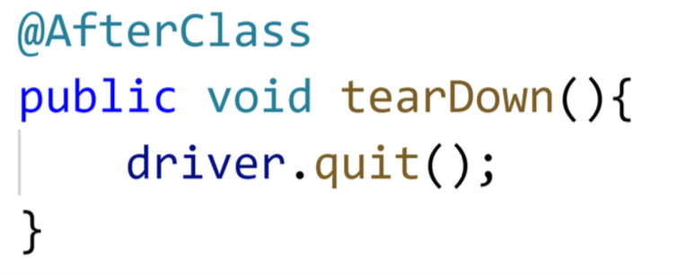
@AfterClass
Runs ONCE after all the methods are DONE.
Usually used for tearDowns, closing browser, killing instances etc…

Slide 16
Assertions
Assert class methods are used to do verifications with TestNG

Slide 17
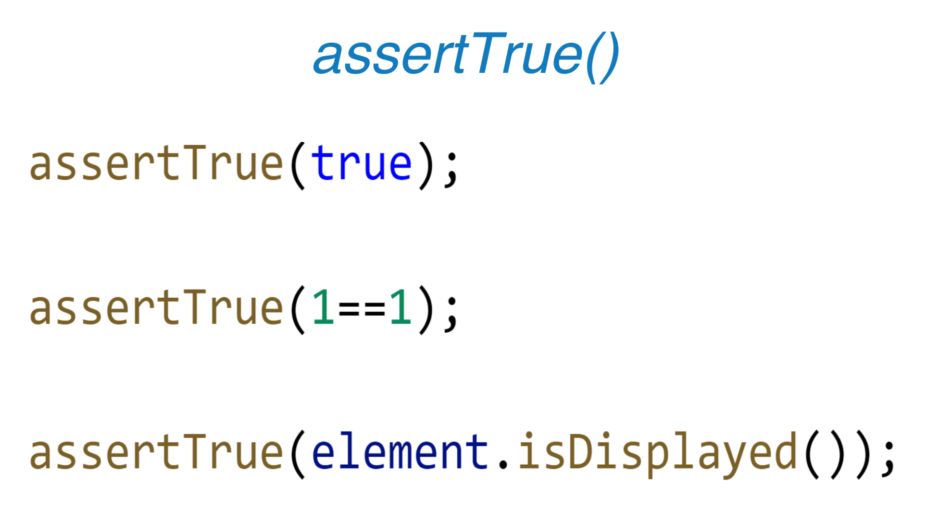
asserTrue();

Slide 18
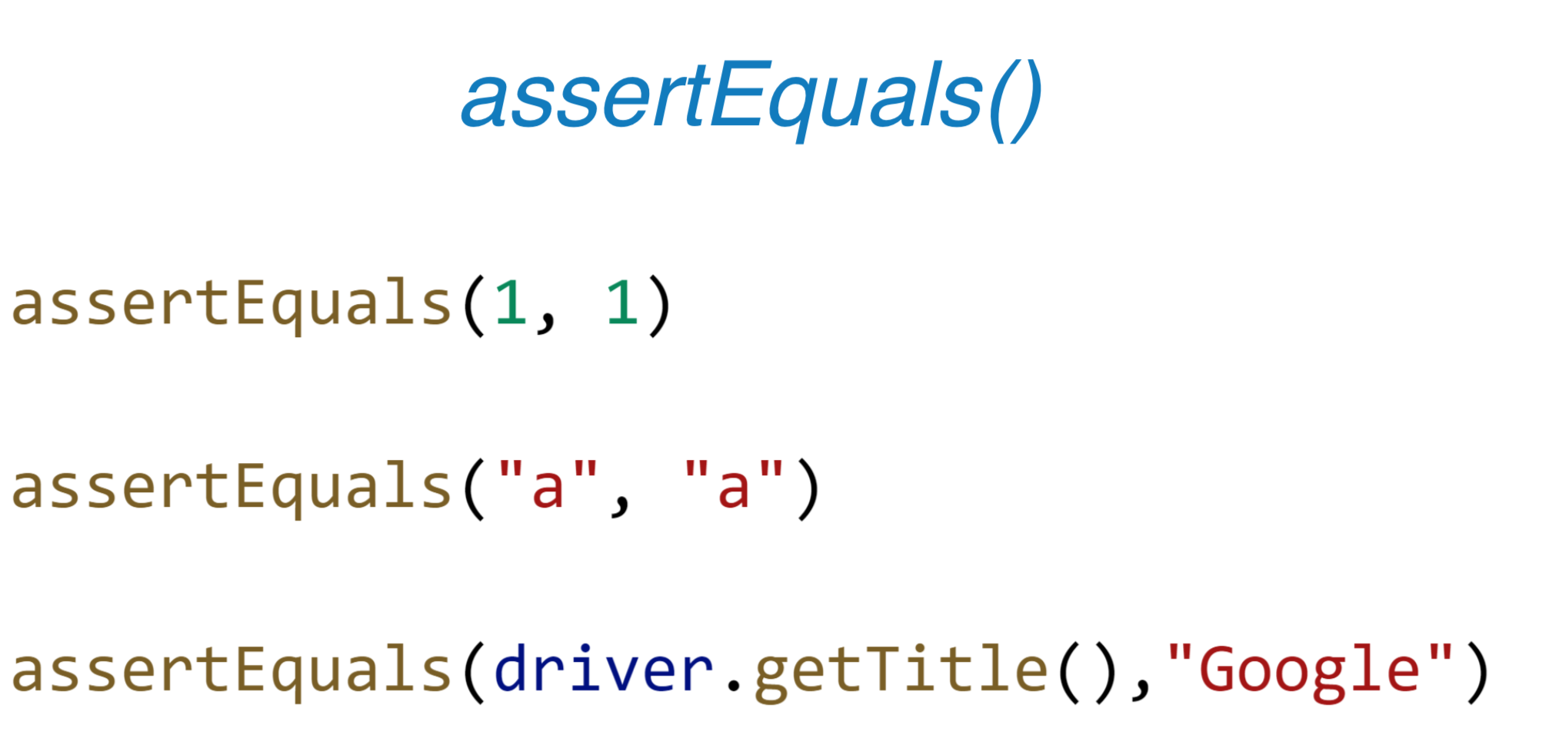
assertEquals() → Checks 2 arguments equal or not

Slide 19
Assert.fail();
If you want to fail your test intentionally…

